Slide 1
Research Title: Roads defect detection using image annotation
Group members Name and Id:
1. Md Sehabub Zaman Pranta - 1611251042
2. Tanvir Ahmed – 1410982042
3. Jannatul Ferdouse Onny - 1631561042
4. Sadia Ahmed Tandra – 1631474042
5. Rokeya Akanda Sriti - 1620165042

Slide 2
Research Lifecyle so far
We are now here.
We started from here
Final Results and Analysis
Implementation of instance segmentation model
Again research for an instance segmentation model
Implementation of object annotation model
Some more data collection
Research for a good object annotation model
Comparison of two different models performance
Model implementation for two class classification
Research for a model to use
Data collection
Research about the topic

Slide 3
Research Lifecyle cont’d
We are now here.
We started from here
Final Results and Analysis
Implementation of instance segmentation model
Again research for an instance segmentation model
Implementation of object annotation model
We are going to discuss about these 4 steps only.
Some more data collection
Research for a good object annotation model
Comparison of two different models performance
Model implementation for two class classification
Research for a model to use
Data collection
Research about the topic

Slide 4
Different types of Image Annotation:
1. Bounding Box Annotation
2. 2D and 3D cuboid Annotation
3. Landmark Annotation
4. Polygon Annotation
5. Polygon Segmentation
6. Semantic Segmentation
7. Video Annotation and so on.

Slide 5
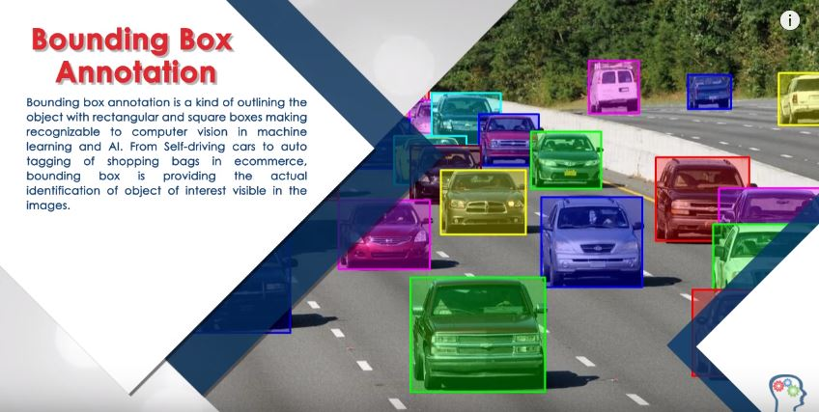
Types of annotation used:

Slide 6
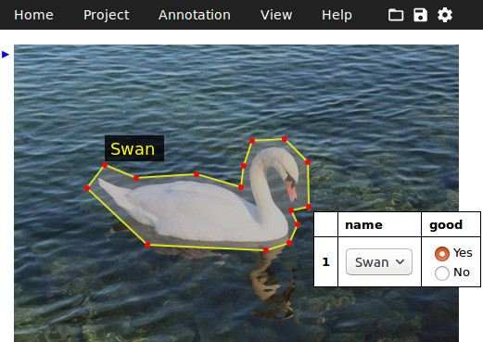
Types of annotation used:
Polygon Annotation permits annotators to plot points on every vertex of the objective item. This annotation technique permits all of the object’s exact edges to be annotated, regardless of its shape.

Slide 7
Different types of Image Segmentation:
1. Region-based Segmentation
2. Edge Detection Segmentation
3. Image Segmentation based on Clustering
4. Instance Segmentation
5. Semantic Segmentation and so on.

Slide 8
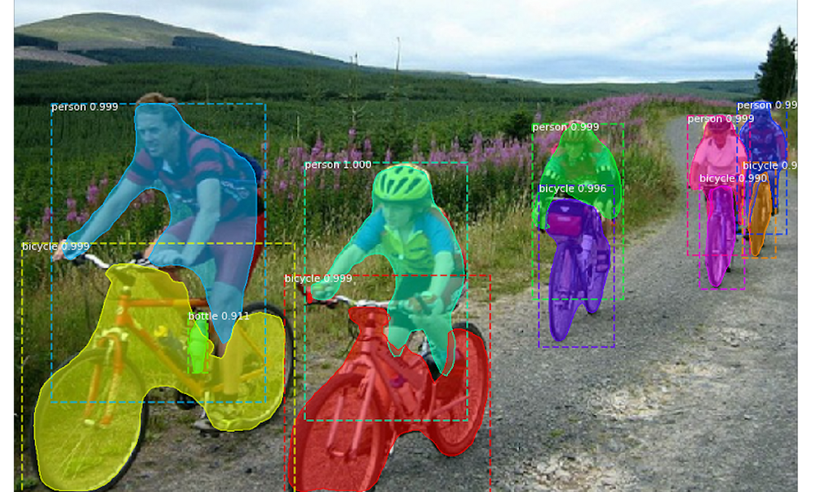
Type of segmentation used:
Instance segmentation is a subtype of image segmentation that identifies each object's instance within the image at the pixel level.

Slide 9
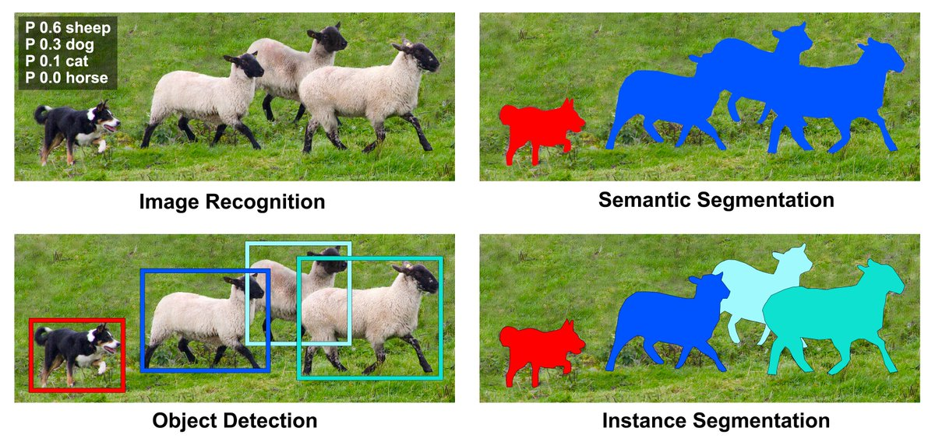
Overall comparison:

Slide 10
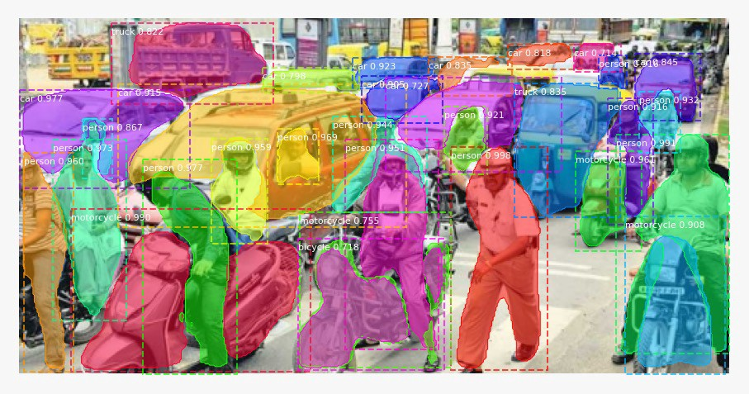
Implementation goal
We will gradually go forward from image annotation to instance segmentation.
Instance segmentation

Slide 11

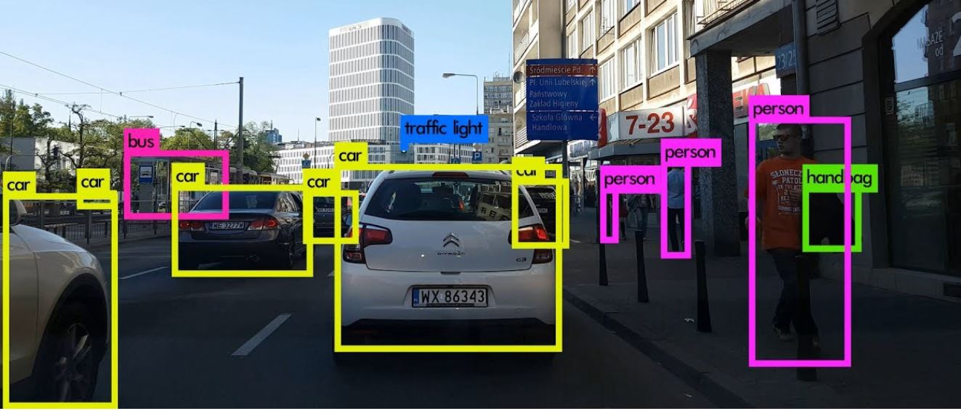
Introduction to object annotation model

Slide 12
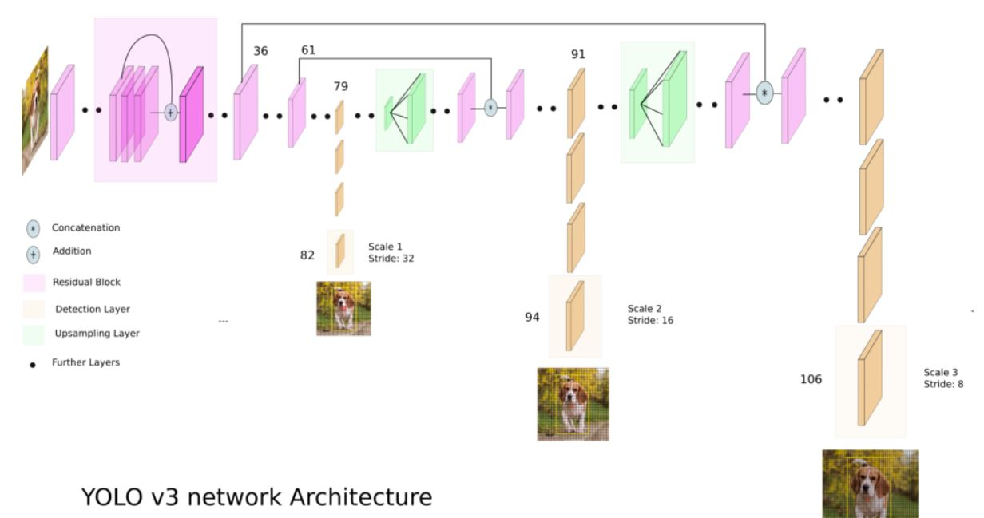
Yolo version 3 network architecture.

Slide 13
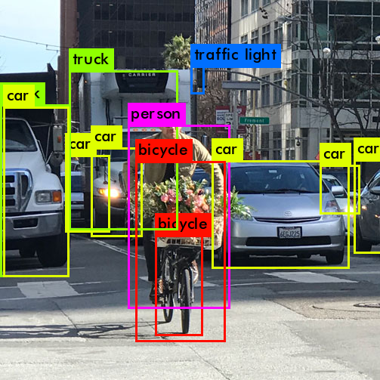
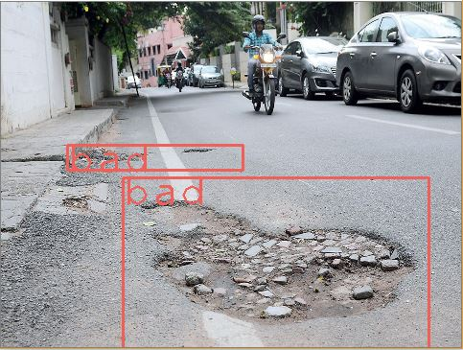
Making the model compatible with our problem.
Transfer Learning
Object Detection
Defect Detection

Slide 14
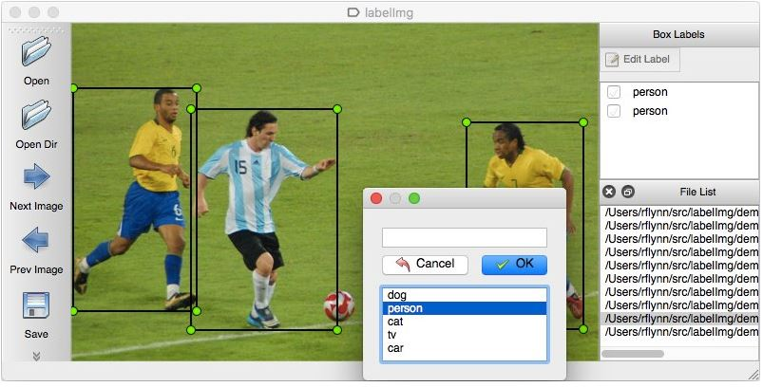
Preparing Dataset for YOLO V3
We used a tool called “labelImg” to label the image samples from our dataset.
This tool returns a text file with the object’s class label and coordinates.
For example: 0 0.470833 0.611111 0.247917 0.583333 which indicates,
<object-class> <x_center> <y_center> <width> <height>
The values generally range from 0 to 1.

Slide 15
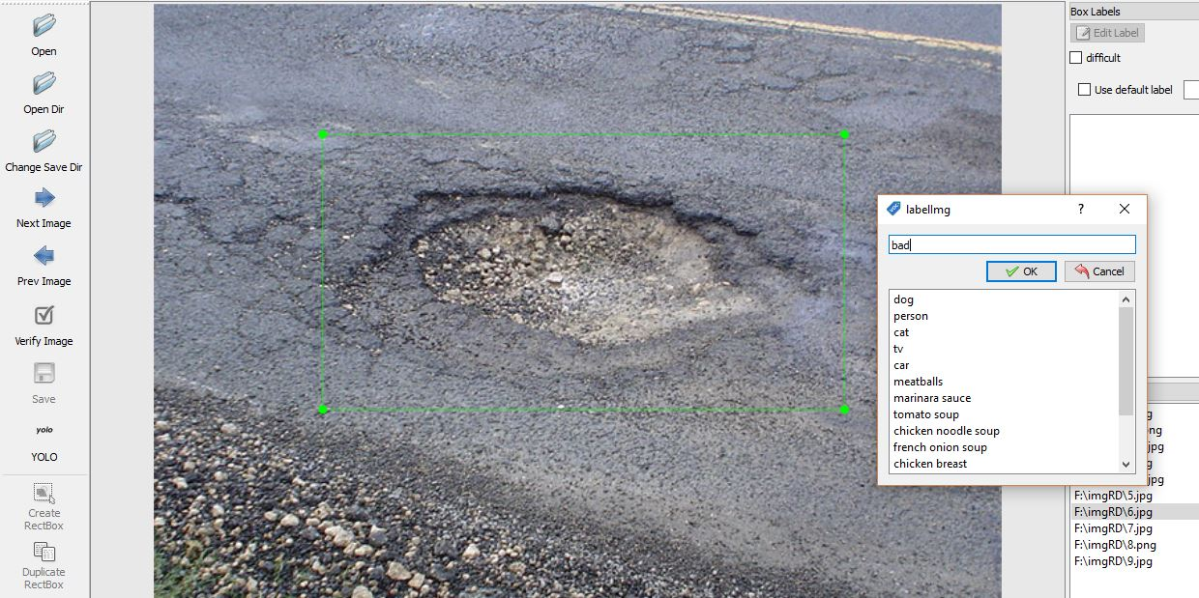
Now the time for training
Before sending data to the model, we have created only one class labeled as “bad” for defected roads.
Instead of training from the beginning, we used some pre-trained weights trained on the COCO dataset, which contained 80 classes to make our training faster.

Slide 16
Training result
Due to data shortage, we have trained with a very small amount of data.
Iteration= epoch * batch_size
Iteration=
Loss=

Slide 17
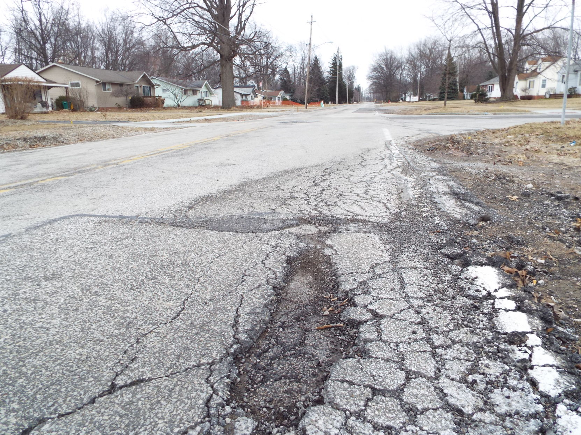
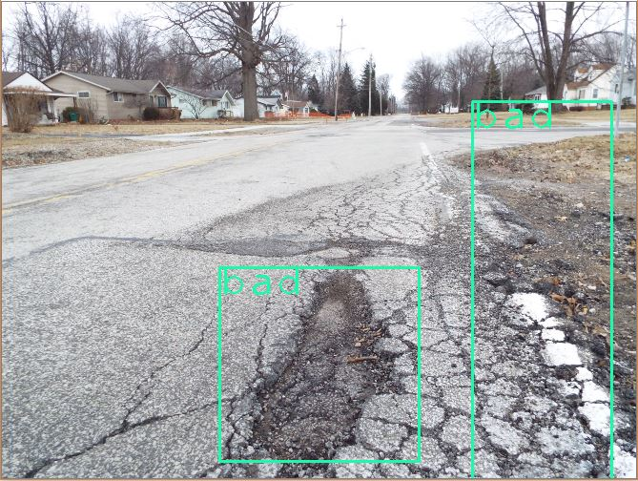
Now testing some samples
Before annotation After annotation

Slide 18
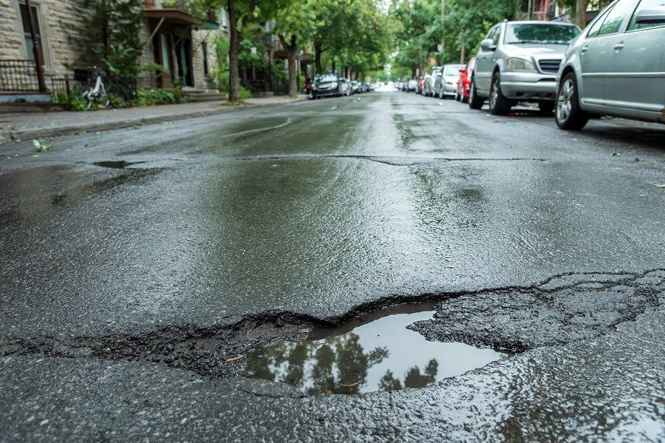
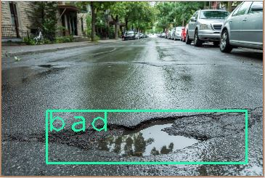
Testing cont’d
Before annotation After annotation

Slide 19
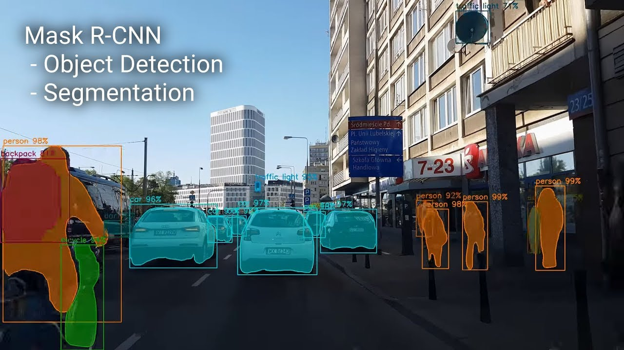
Introduction to image segmentation model

Slide 20
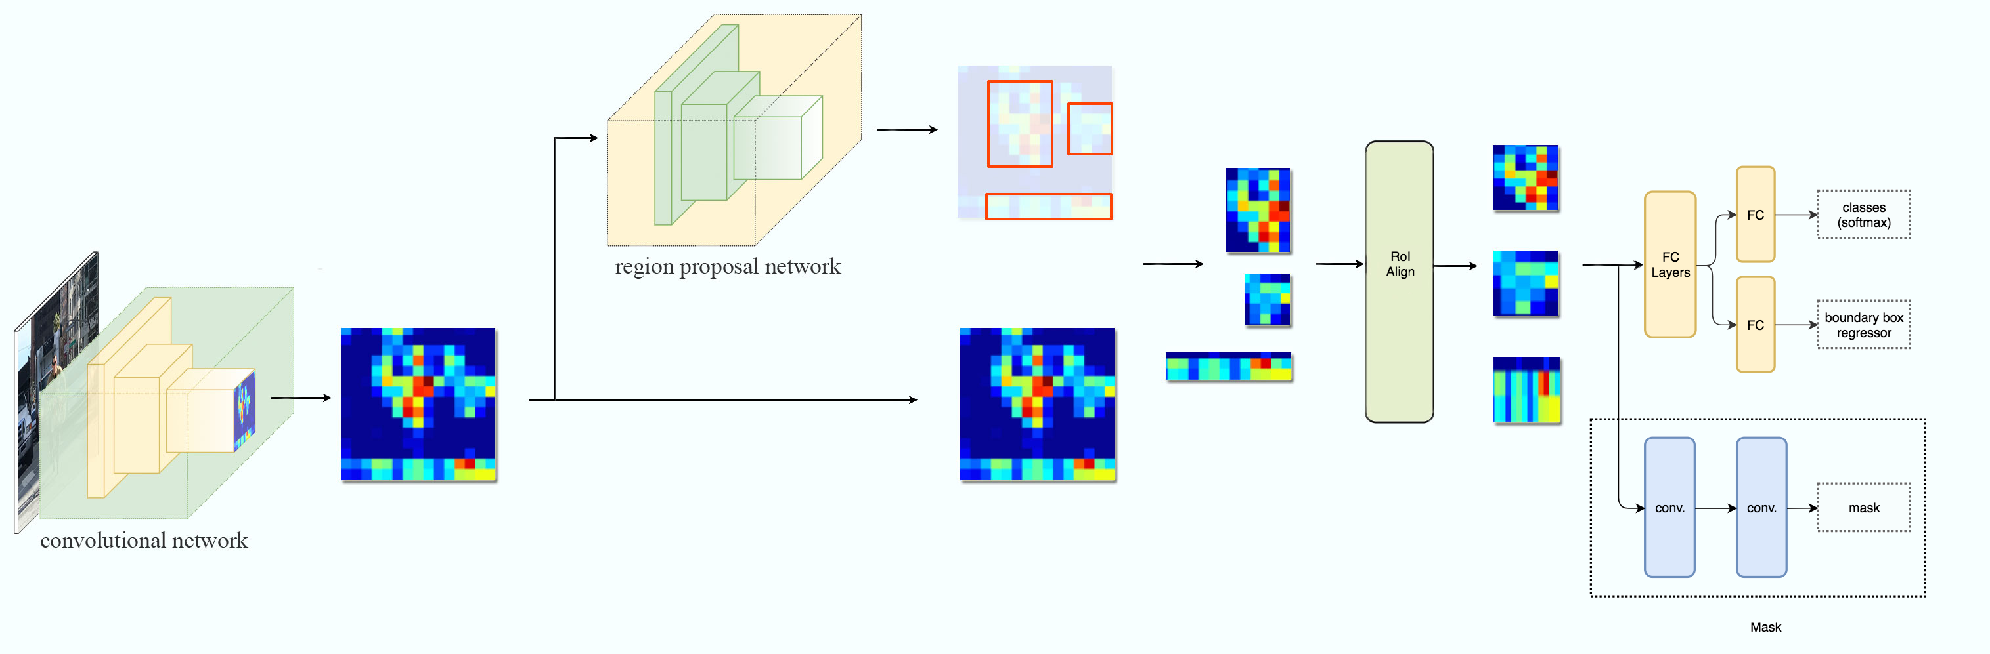
Mask R-CNN Architecture

Slide 21
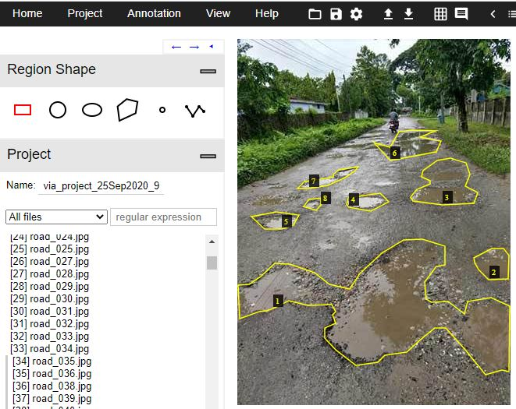
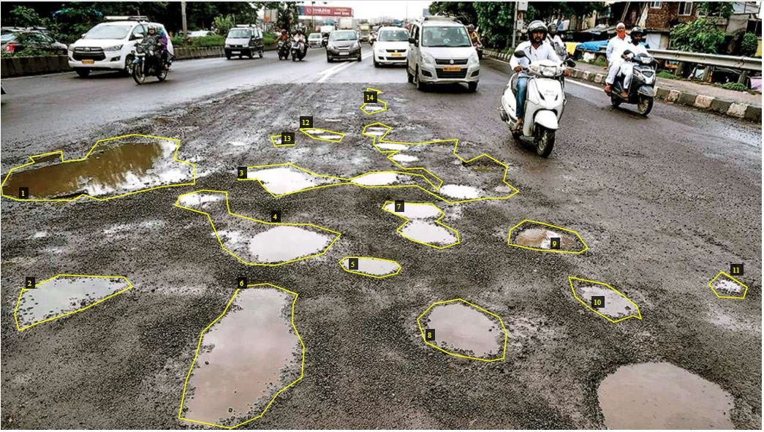
Preparing the dataset

Slide 22
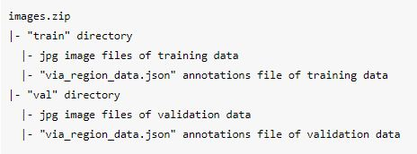
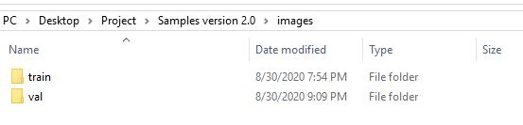
Dataset structure

Slide 23
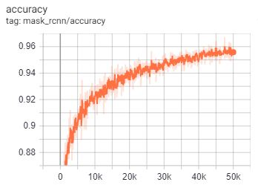
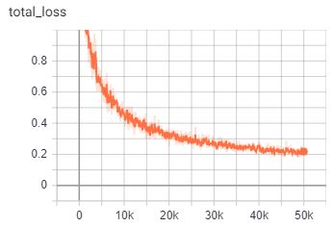
Training result analysis
Due to data shortage, we have trained only on roughly 700 samples.
Resnet-101 backbone with 32 batch size

Slide 24
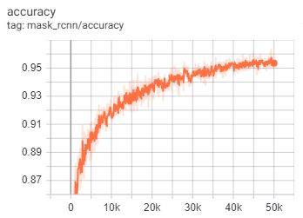
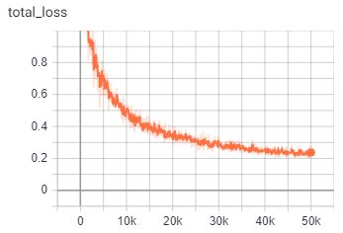
Result analysis cont’d
Resnet-50 backbone with 64 batch size

Slide 25
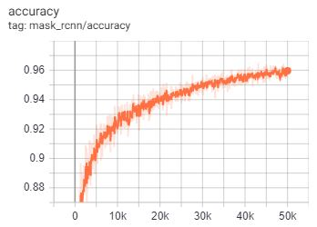

Result analysis cont’d
Resnet-101 backbone with 64 batch size

Slide 26
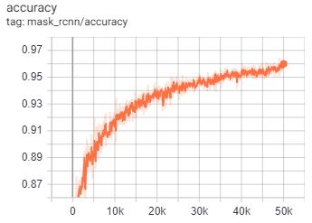
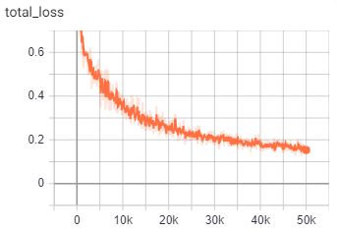
Result analysis cont’d
Resnet-50 backbone with 512 batch size

Slide 27
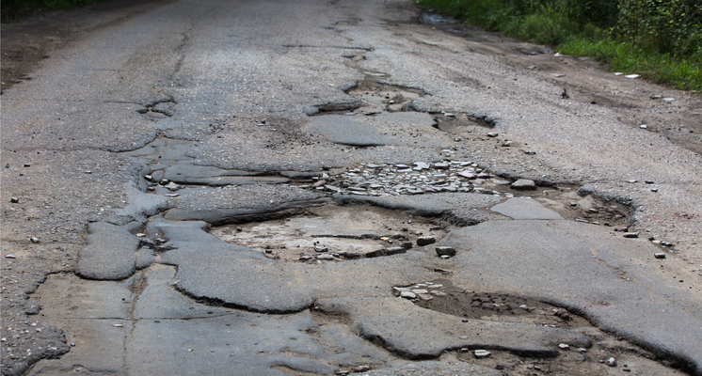
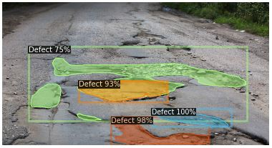
Testing some samples
Base Image Segmented image

Slide 28
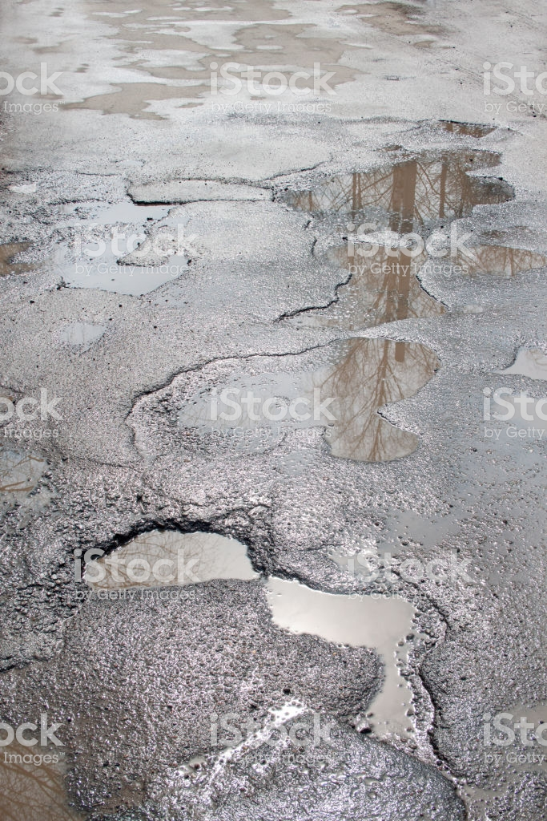
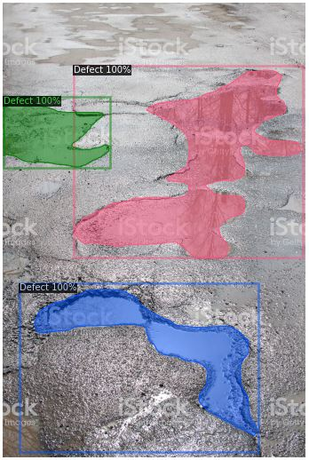
Testing cont’d
Base Image Segmented image

Slide 29
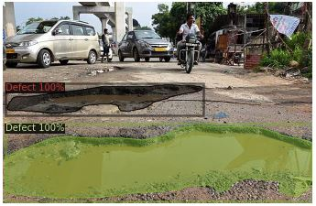
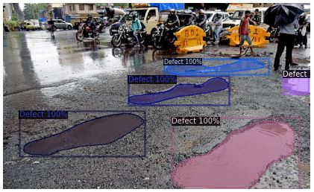
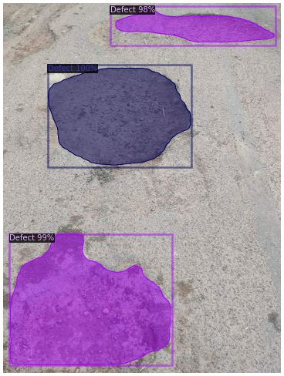
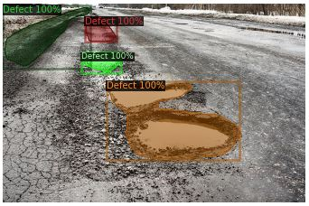
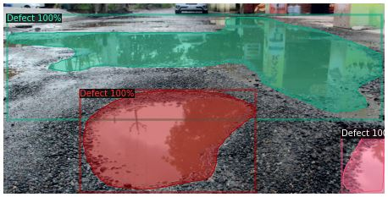
Some more testing results

Slide 30
Evaluating validation set
Iteration | Backbone | Batch Size | AP | AP₅₀ | AP₇₅ | AP_{S} | AP_{M} | AP_{L}
50k | ResNet-50 | 512 | 17.138 | 41.726 | 11.744 | 0.000 | 11.623 | 23.264
50k | ResNet-101 | 64 | 19.693 | 46.633 | 13.456 | 0.000 | 14.357 | 26.079
50k | ResNet-50 | 64 | 17.016 | 39.925 | 9.624 | 0.000 | 11.517 | 23.012
50k | ResNet-50 | 32 | 15.737 | 38.906 | 9.061 | 0.480 | 9.413 | 21.526

Slide 31
Evaluation cont’d
Iteration | Backbone | Batch Size | AP | AP₅₀ | AP₇₅ | AP_{S} | AP_{M} | AP_{L}
50k | ResNet-50 | 512 | 17.138 | 41.726 | 11.744 | 0.000 | 11.623 | 23.264
50k | ResNet-101 | 64 | 19.693 | 46.633 | 13.456 | 0.000 | 14.357 | 26.079
50k | ResNet-50 | 64 | 17.016 | 39.925 | 9.624 | 0.000 | 11.517 | 23.012
50k | ResNet-50 | 32 | 15.737 | 38.906 | 9.061 | 0.480 | 9.413 | 21.526
High
Low

Slide 32
Further improvements
Could be used GAN or training with more samples.
Using active learning could decrease the annotation effort.
Testing on a larger validation set to get the actual performance.

Slide 33
The End! Thank You Everyone!

Slide 34
References:
https://www.analyticsvidhya.com/blog/2019/04/introduction-image-segmentation-techniques-python/
https://hackernoon.com/illuminating-the-intriguing-computer-vision-uses-cases-of-image-annotation-w21m3zfg
http://www.robots.ox.ac.uk/~vgg/software/via/
https://github.com/facebookresearch/detectron2
https://github.com/AlexeyAB/darknet
http://www.robots.ox.ac.uk/~vgg/software/via/
https://github.com/tzutalin/labelImg

